Slide 1








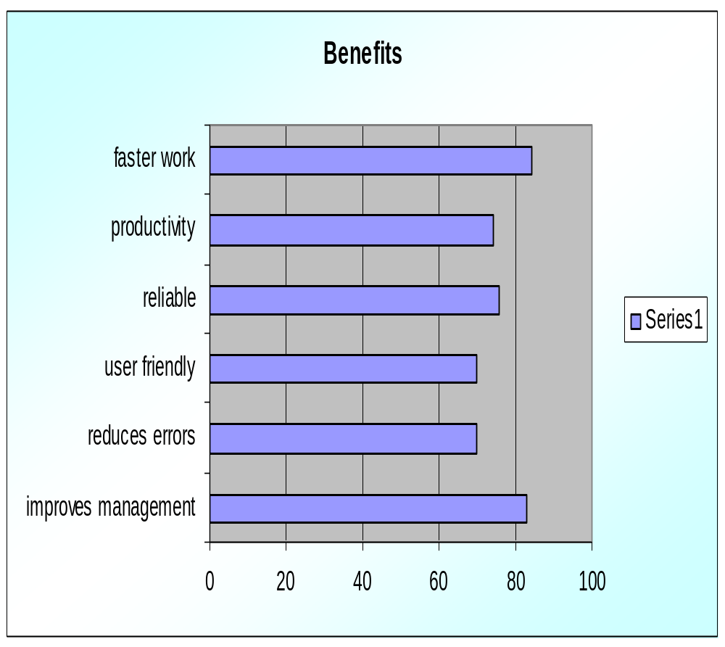
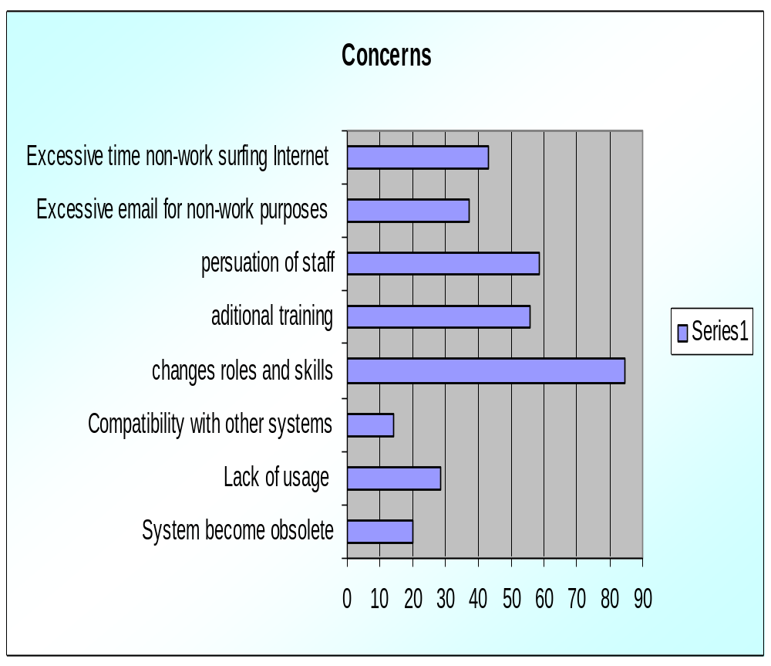



THE IMPACT OF TECHNOLOGY ON HRM
Jasira Sohail, 2371
Supervisor: Mr. Ata-ur-Rahman
PAF – Karachi Institute of Economics & Technology
Objective
Highlight the benefits that can be achieved by the usage of technology and concerns as well.
To create understanding about the advantages gained by hr technology so people invest in it.
Methodology
Population: Employees working in Karachi
Sample size: 70
Data collection tool:
Questionnaire
Findings
Conclusion
The majority agreed with the benefits of technology. They pointed out that Skill, Training, Flexibility, Speed and functionality leads towards a good performing system.
People in our business environment treat technology as a tool for automation.
Concerns like sharing of power, changes in roles and skills, quality of input, changing to new system, employees spending time on internet stops people from considering hr technology.

